Slide 1
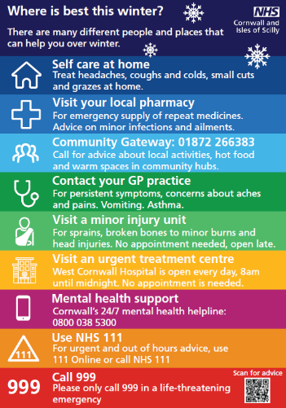
Where is best external comms campaign
“Where is best” external winter campaign launches on w/c Monday 27 November
This compliments the internal “Where Best Next” campaign and aims to:
Increase understanding among residents of “Where is best” if they are ill or injured
Raise awareness of the range of community support available and of “real stories” of people discharged from hospital or avoiding admission
Empower people to stay well and to self care for minor conditions
An overview of our H2 winter plans Workforce update December 2023

Slide 2
Setting the scene
Explaining the intention of our winter plans
Plans are underway across Cornwall and the Isles of Scilly to offer more health and care services from the comfort of people’s home and supported in local communities this winter.
We want to deliver the right care, in the right place and at the right time for our residents.
We are building a network of local voluntary, community and healthcare services to help us reduce unnecessary Emergency Department (ED) attendances and non-elective admissions.
The goal is to optimise patient care, reduce ambulance delays, ED attendances and non-elective admissions, ensuring a resilient and patient-centred healthcare system over winter.
2

Slide 3
What’s different this winter
Delivering the right care, in the right place and at the right time
Additional on the demand primary care appointments between Dec-March 2024.
Extra places in CATUs to provide an alternative place for patients
Capacity for 212 people in virtual wards
A central phone number for staff to use to access the CCH and IToCHs
Extended use of Integrated Transfer of Care Hubs (IToCH) 7 days a week, 8am-8pm
A new Care Co-ordination Hub (CCH) used by SWAST and Kernow Health CIC
New Right Care car to provide an urgent response to patients in their own homes
New X-ray car in the West ICA able to X-ray patients at home/care homes
Additional packages of care and by February, the development of a dementia hub
The impact from our winter ways of working should:
Improve care, support, safety and outcomes for our people
Reduce Emergency Department (ED) attendance and admissions to Royal Cornwall Hospital
Speed up discharge from hospitals, with more packages of care that reduces bed occupancy
Reduce ambulance delays, improve ambulance response times and ED performance targets
3

Slide 4
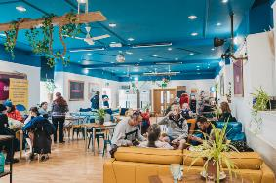
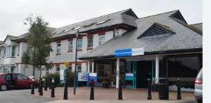
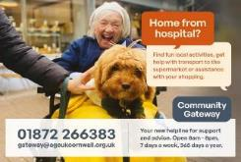
SWASFT Care Co-ordination Hub Empowers staff to access multiple community pathways, with the aim to increasing community referrals, reducing the time at scene for staff and getting ambulances to other patients more quickly.
Our virtual wards support people whose acute respiratory or frailty condition could be managed at home as an alternative to hospital 7 days a week.
Extra GP appointments at new primary care hubs Primary care hubs are being set up across Cornwall to ease the daily demand on General Practice (GP) and allow patients with long term conditions to be proactively managed over winter.
Winter plan explained
We’re focusing on discharge and getting people home from hospital as soon as possible with support from NHS services at home and community.
Community hubs Our network of 50 community hubs offer our people the chance to get help and support with mental, physical health and wellbeing including tackling loneliness and isolation with a schedule of regular events and activities.
Integrated Transfer of Care Hub Staff across Primary Care, RCHT, CFT can call our integrated transfer of care hubs (iTOCHs) to arrange ‘where best next’ for their patients, at home or supported by their community.
Community Assessment and Treatment Units (CATUs) provide an alternative for assessing older people in Bodmin, Camborne and Redruth and West Cornwall Hospital
Community Gateway service Open everyday to help residents and health professionals to find community based support tailored to people’s individual needs.
4

Slide 5
How you can help deliver our Winter plan:
Understand the plans for winter so we all deliver the right care, in the right place and at the right time for our residents.
Use the Integrated Transfer of Care Hubs (IToCH) to help find alternatives to hospital admission and to support discharge
Work with providers to keep packages of care open for clients/patients admitted to hospital for the required time period
Refer or signpost people to the community hubs and community gateway
Follow infection control advice and do all you can to keep healthy and well
Supporting any requests to work in different areas to support system flow
Thank you!
5

Slide 6
Winter communications campaign
November 2023- March 2024
Showing our target audience at home… Where we want them to be!
6
Notes:
Perfect weeks

Slide 7
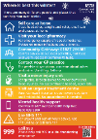
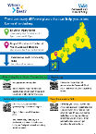
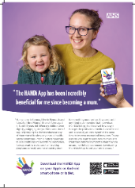
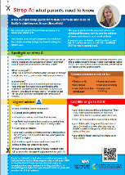
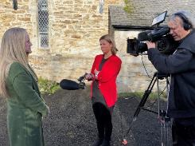
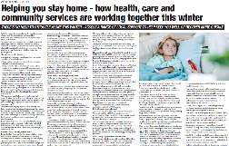
Where is best communications campaign
Focusing on home and community is best
Radio campaign with Pirate, Heart and Rewind: Nov 23-Feb 24
Click on audio symbol to listen!
Where is best comms toolkit
Printed materials on display in GPs, hubs and our hospitals
Our campaign webpage: Where is best for you this winter? - NHS Cornwall and Isles of Scilly
Media advertorials, online and out of home advertising - targeting families
Proactive media moments throughout winter focusing on community and admission avoidance
Winter wellbeing booklet printed and distributed to GP and hubs
Promoting the Community Gateway
Winter wellbeing tips advent calendar with Hall for Cornwall’s Peter Pan pantomime cast, senior leaders and frontline staff.
View online: Where is best this winter? - Cornwall Live
7

Slide 8
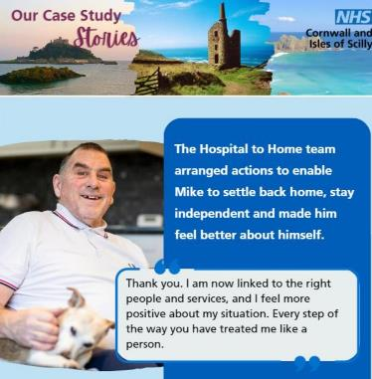
Real life case studies
Telling the stories of our winter services in action
We will be promoting weekly case studies showcasing the positive stories of how your work is supporting our people at home
We are using stories of people who have benefits from our winter plans – those who use our virtual wards, community hubs to the extended hours at West Cornwall Hospital
We will use these stories to increase awareness and build trust to our internal and external audiences
We want to celebrate our great teams in action
Please tell us your stories by emailing ciosicb.contactus@nhs.net
8

Slide 9
Extra GP appointments at our Primary Care Hubs
Winter plan in action…
Recruitment is underway for the extra GP appointments at our primary care hubs We’d appreciate your support in promoting these roles, which will be staffed through 'portfolio' additional hours recruited across our primary care network, the ICS and externally - targeting recently retired and registered GPs, paramedics and nurses who have suitable experience in minor illness. Find out more about the roles and how to apply
9

